Slide 1
Beyond Ohms Law - using the CL-1919 for EV training
Webinar 2024-04-12

Slide 2
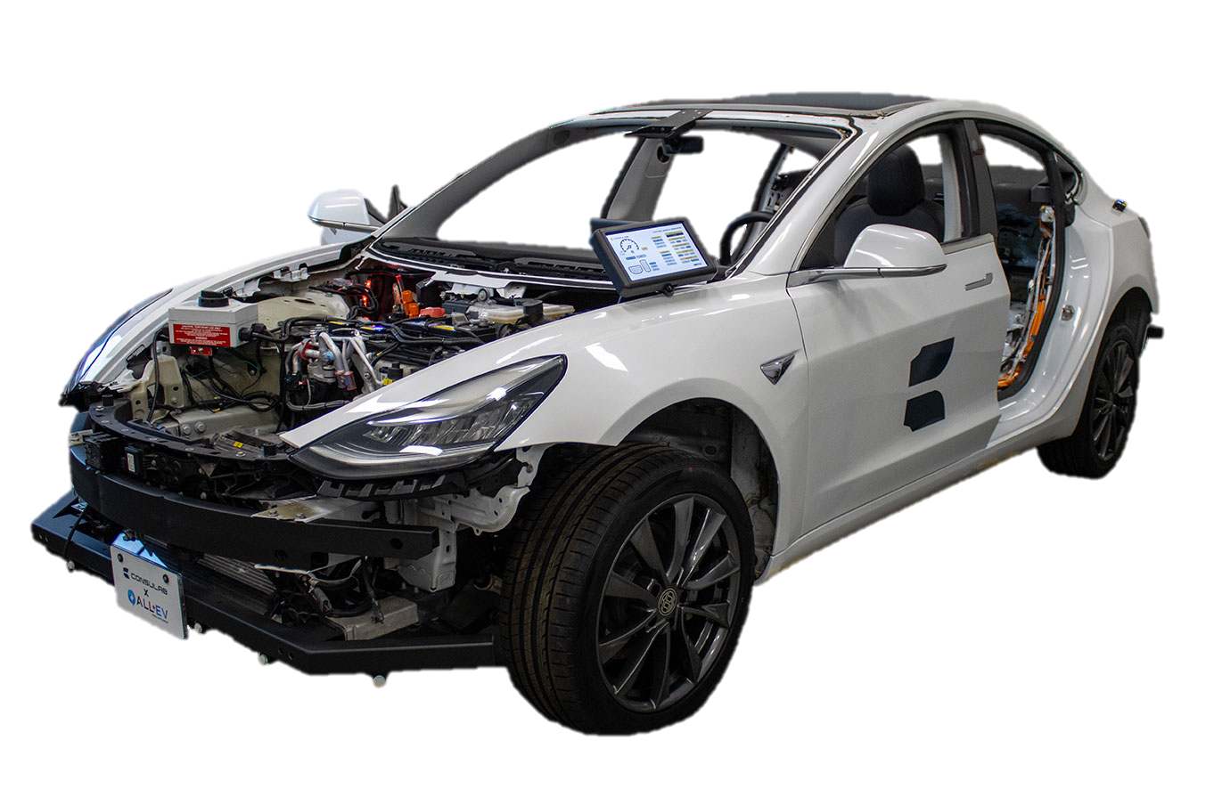
Electrical for EV’s
It’s all electrical
Systems integration
Multiplexing & other networks
Modems and GPS
iOT and app integrations
Infotainment
ADAS and autonomous driving

Slide 3
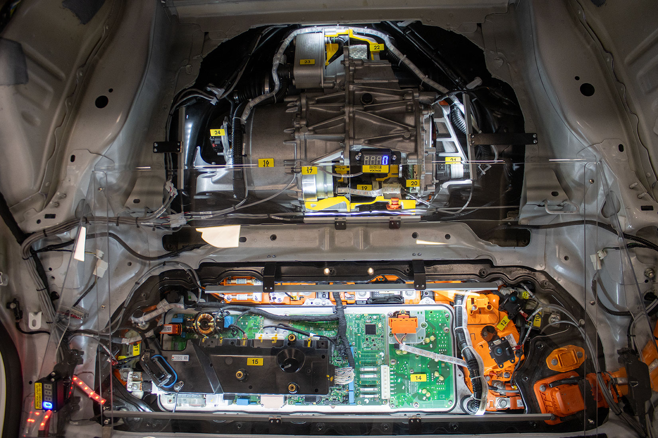
Electrical for EV’s
BMS
PCS
HVIL
3 Φ motors
Brushless DC
AC electrical
400-1000V
48V
Lithium ion

Slide 4
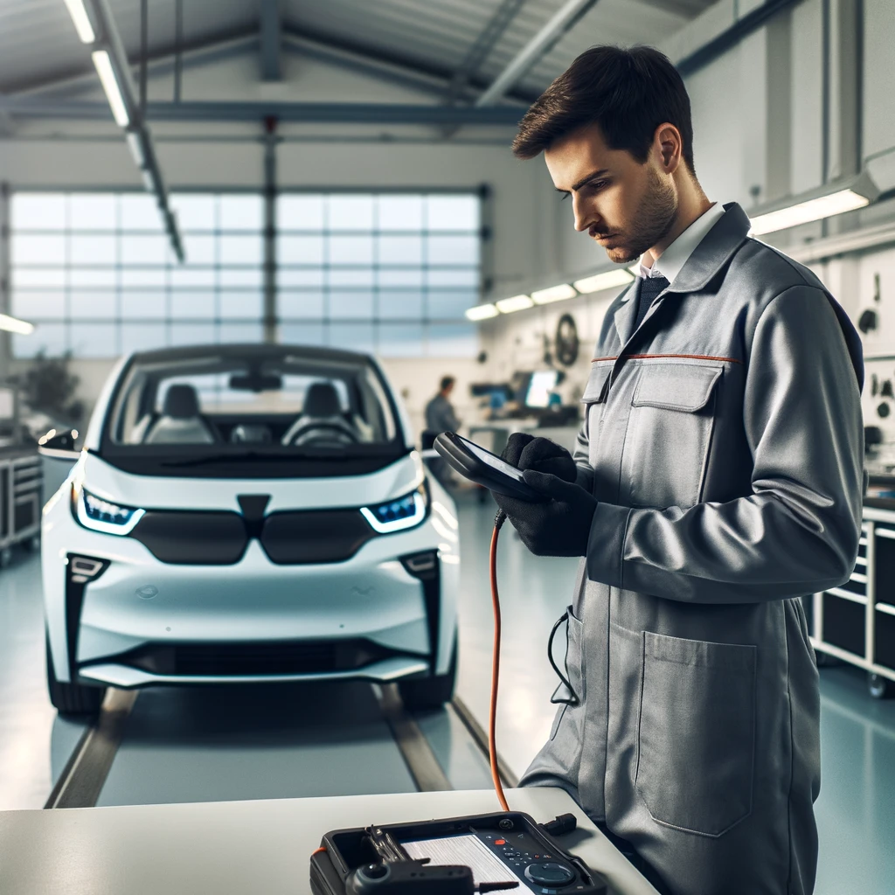
Electrical for EV’s
It’s not all 48V and three phase and complex
Keep it simple
The basics still apply
Use what you know
Use what you have
Focus on the fundamentals
Many technicians just need to interact safely with the vehicle

Slide 5


Electrical for EV’s
New certifications
CSA group
ASE xEV

Slide 6
CSA Group
Prerequisites
High level exam
Master technicians
Experience & schooling required
Recommended for instructors
$$
https://www.csagroup.org/store-resources/documents/pc-programs/Automotive-EV-Technician-Certification-Guide-PCP-04-March-2024.pdf

Slide 7
ASE xEV
Level 1
Entry level students
No prerequisites
Focus on EV safety awareness
Recommended for students and apprentices
$
https://www.ase.com/dist/docs/ASExEVElectricalSafetyStandardsVersion1LevelONE.pdf

Slide 8
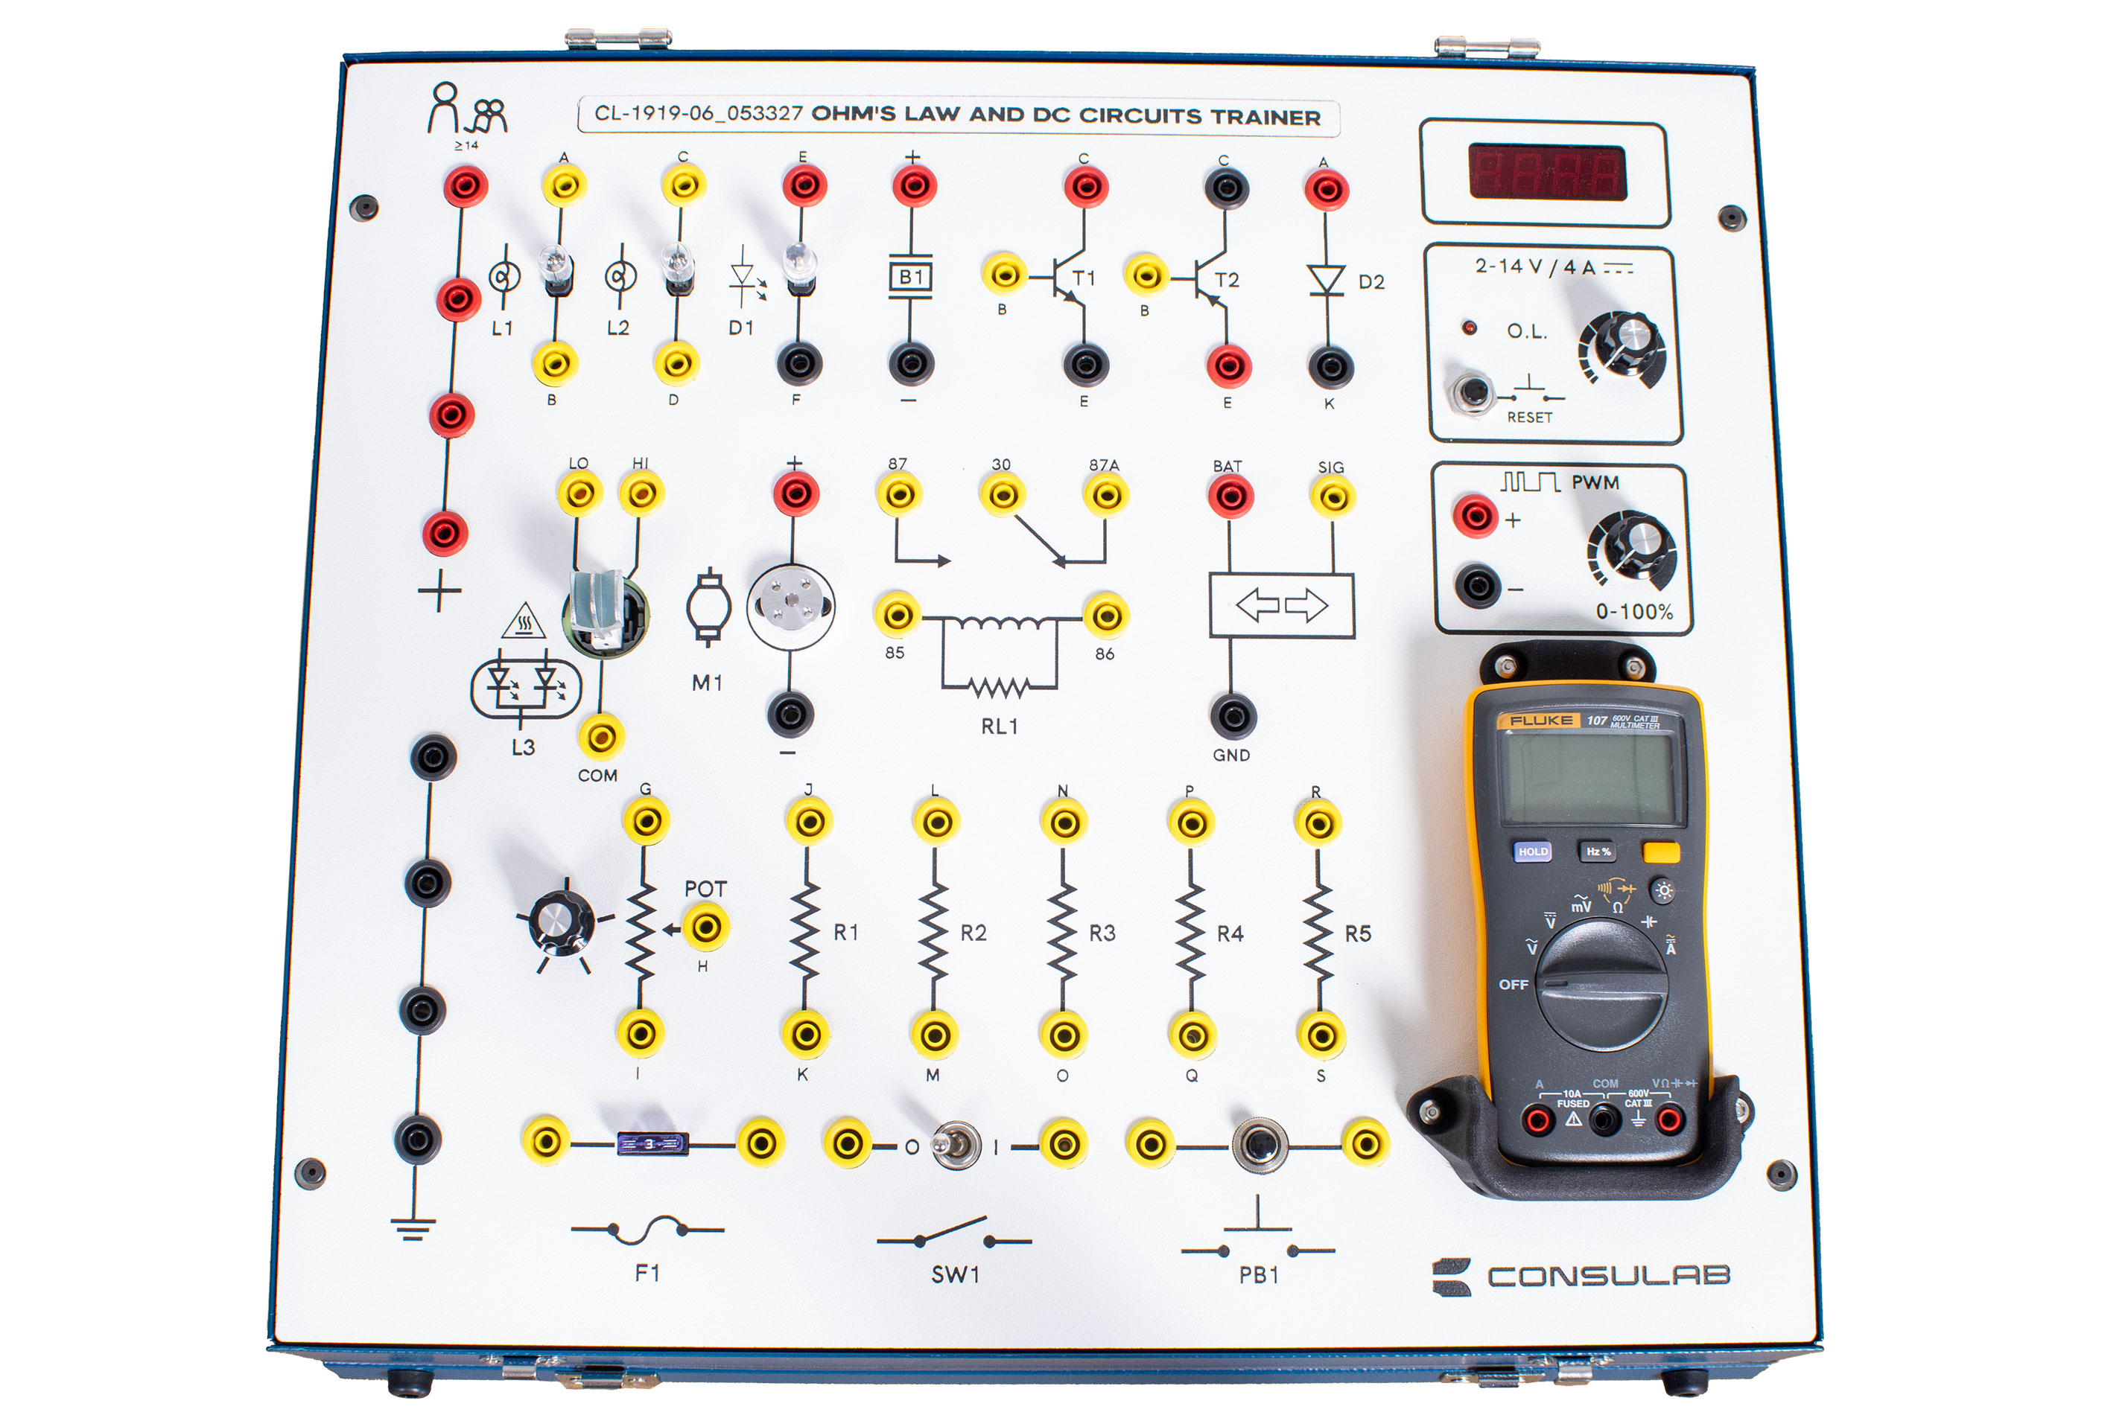
CL-1919 Ohm’s law trainer

Slide 9
Circuits
Regenerative braking
Hybrid drive mode
Contactors and pre-charge
HVIL high voltage interlock loop
Multimeter function

Slide 10

Teaching regenerative braking

Slide 11
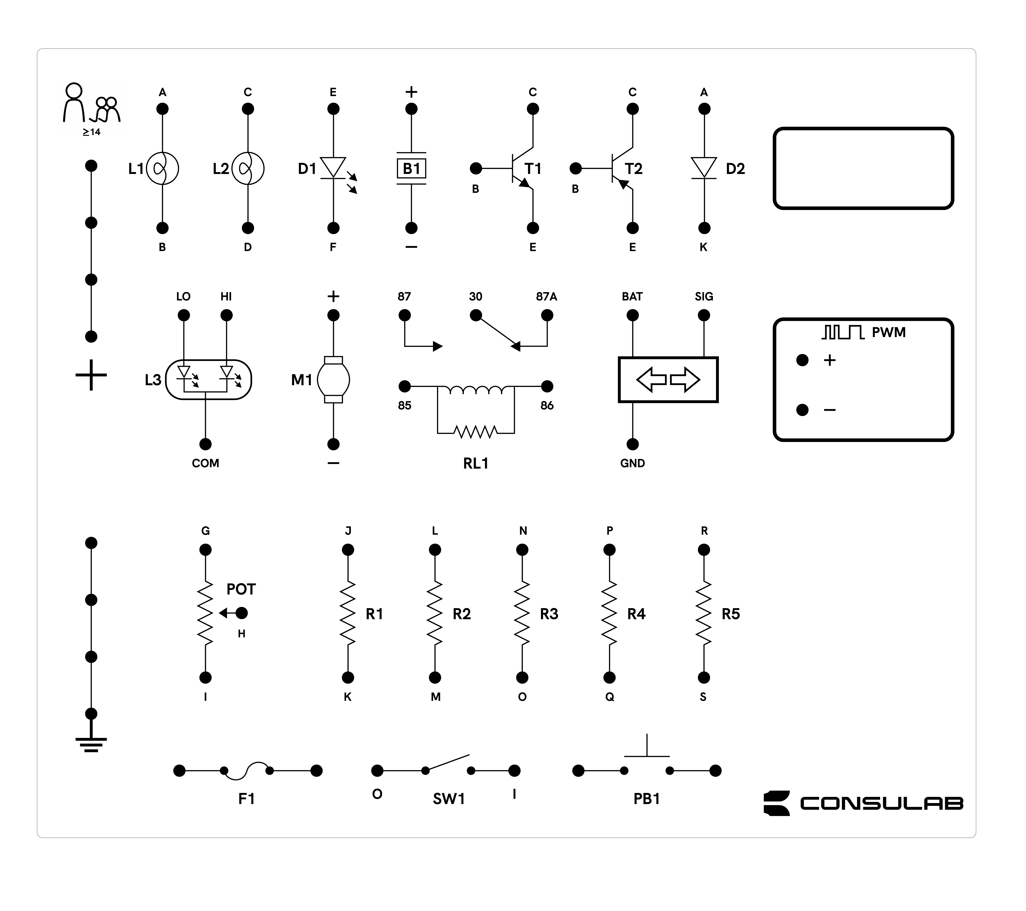

Regen
14.25V

Slide 12
Teaching hybrid drive mode

Slide 13
Hybrid
14.25V

Slide 14
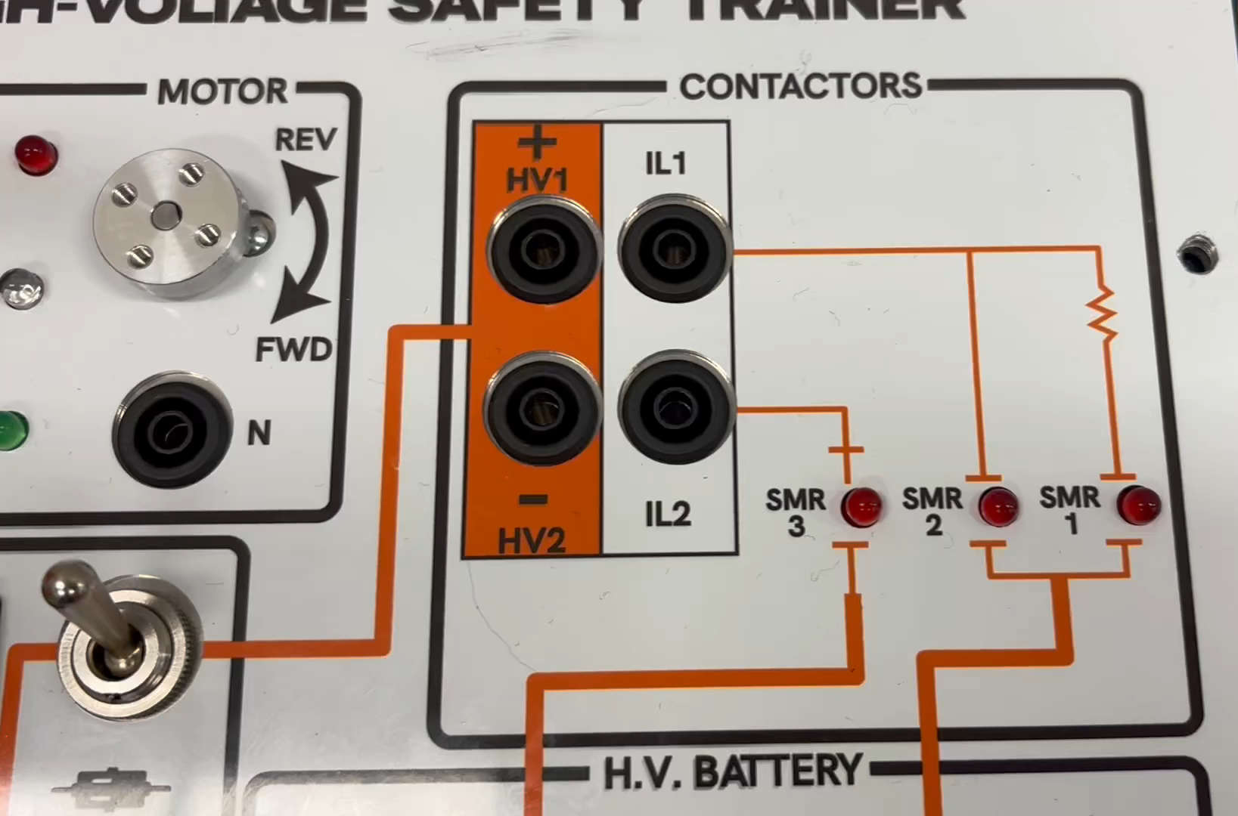
Teaching contactors and precharge

Slide 15
Pre-charge
14.25V

Slide 16
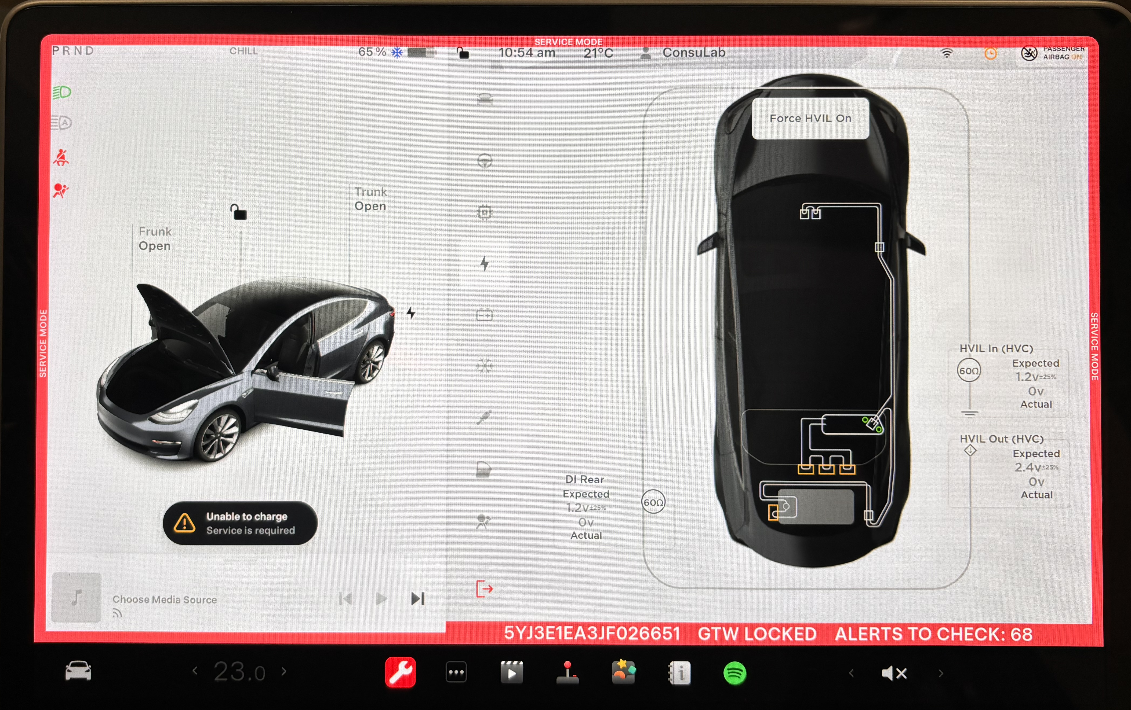
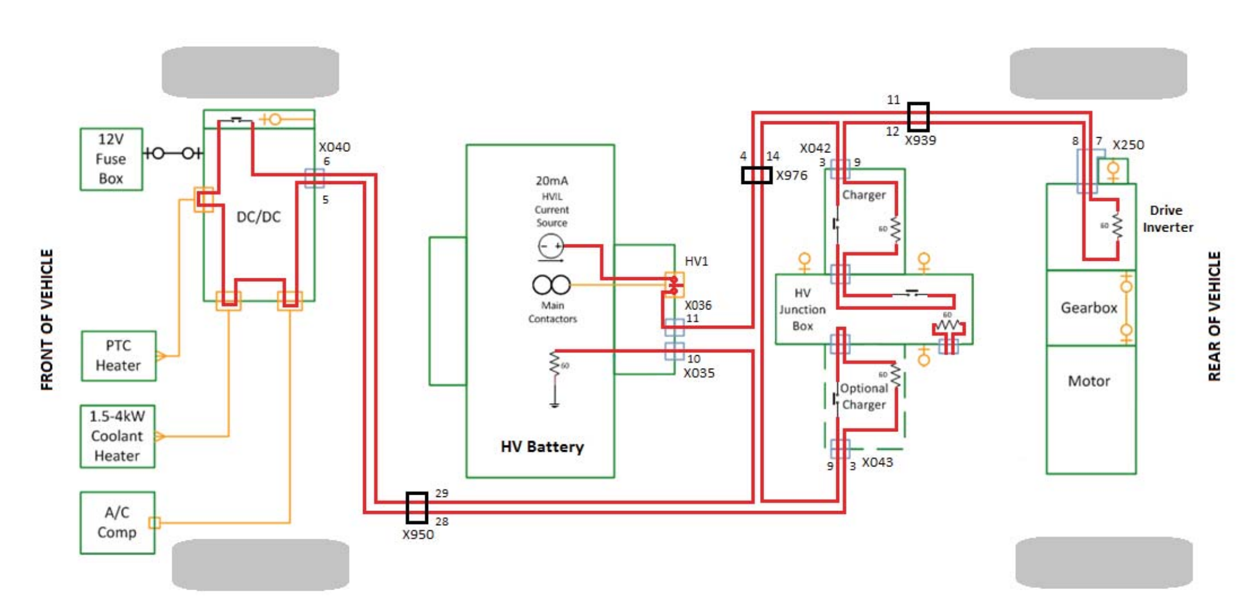
Teaching HVIL

Slide 17
HVIL
14.25V

Slide 18
Multi meter
Measuring volts
Measuring amps
Measuring ohms
It’s all just measuring volts in a different way. With the math done for you!

Slide 19

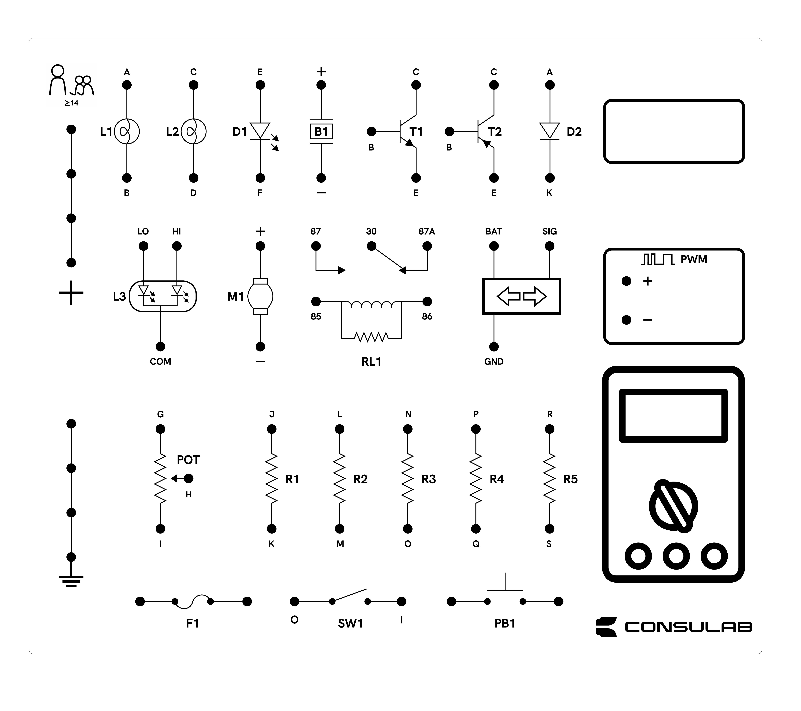
how to get ohm’s from volts
Voltage
Amps
8.0V
Voltage

